Slide 1
There are additional opportunities to enhance and customize the consumer shopping experience
Strategies
Theme/Concept
Example
Expanded
Product / Service Information
Providing product / service information that is unavailable inefficient to provide through other means.
Dell Computers
Virtual Vineyards
Herman Miller
Enhanced Merchandising Techniques
Improving the consumer’s shopping experience by using enhanced merchandising techniques like solution- and suggestive-selling (cross-selling and up-selling), and also providing opportunities for impulse purchase.
J.Crew
Herman Miller
Macy*s
Greatfood.com
Personalization
Personalizing the offer to generate a unique mix of products and information to each consumer based on their past on-line shopping behavior or other preferences
Giving customers some control over what & how content is displayed, enabling them to customize their shopping experience
Garden.com
Amazon.com
Ticketmaster
Bluefly.com
Product Recommendations
Recommending specific products / services based on individual user profiles and preferences
Allowing consumers to enter recommendations and comments about the offer, and making those comments available to others
Greatfood.com
Amazon.com
CDNow
Clinique
Convenience / Efficiency
Storing customer information (e.g. addresses, credit card information) so speed the purchase / checkout process
Testing site usability to ensure that it provides consumers with a fast, efficient shopping experience
egift.com
buy.com

Slide 2
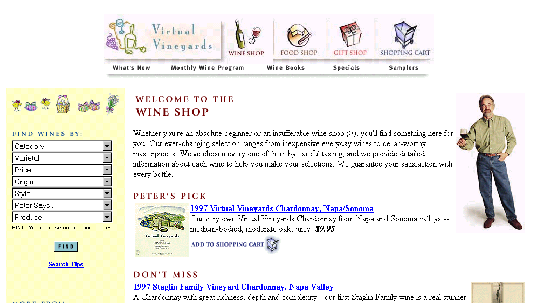
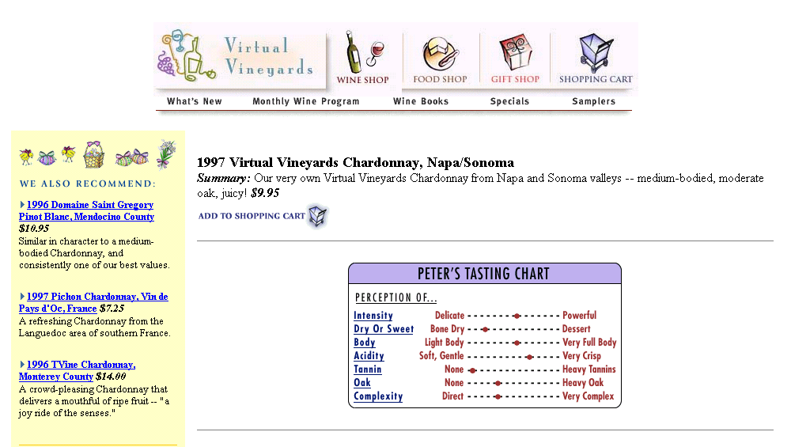
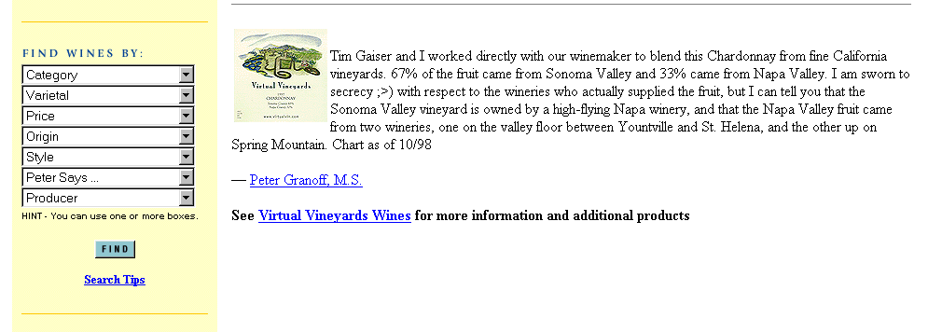
E-Biz Opportunity: Enhancing Shopping Experience; Expanded Product/Service Info
Website example: www.virtualvin.com
URL: http://www.virtualvin.com
Tasting chart
Each item is hot linked so the consumer can clink on the link to get more product information.
More product description/ background

Slide 3
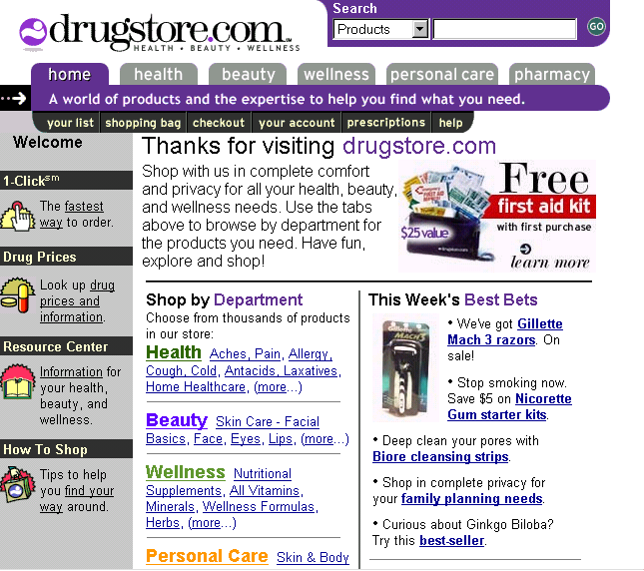
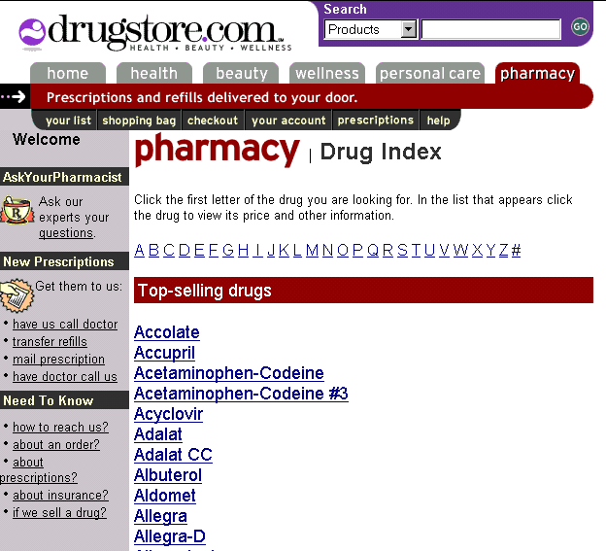
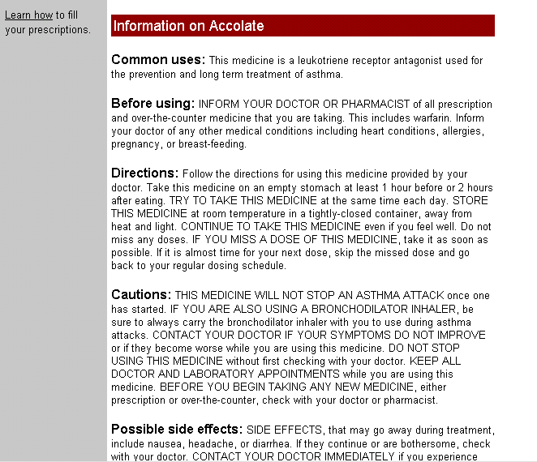
E-Biz Opportunity: Enhancing Shopping Experience; Expanded Product/Service Info
Website example: www.drugstore.com
URL: http://www.drugstore.com
A comprehensive drug index that consumers can use to look up more information on a product (ex. Accolate).
Drug prices and information
Information on Accolate includes common uses, directions, cautions and side effects.

Slide 4
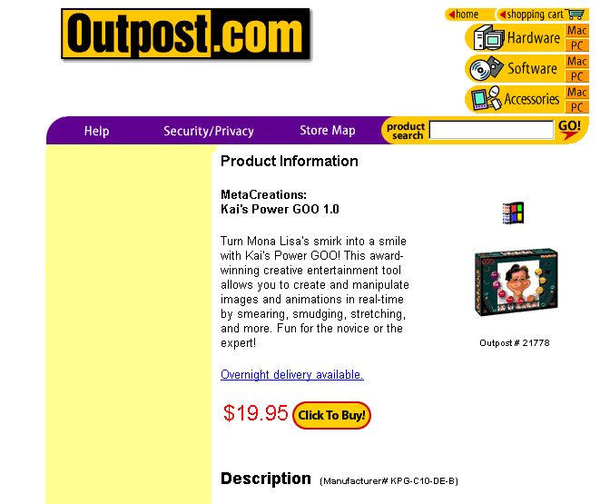
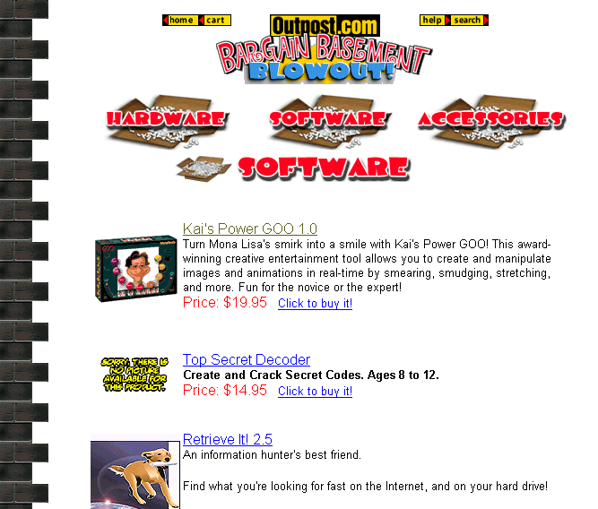
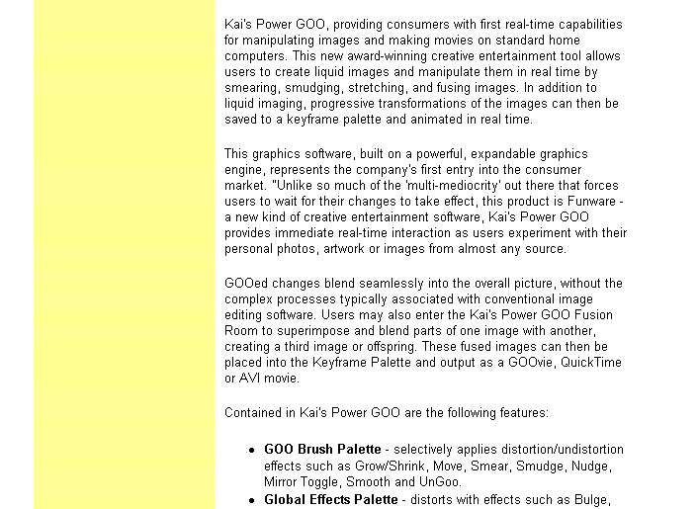
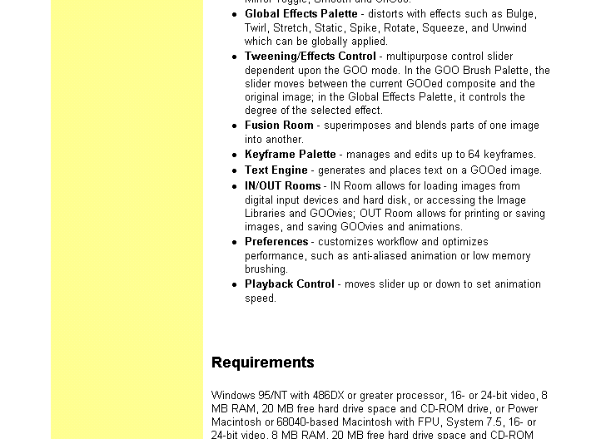
E-Biz Opportunity: Enhancing Shopping Experience; Expanded Product/Service Info
Website example: www.outpost.com
URL: http://www.outpost.com
In addition to a brief description of the product, there is a link the consumer can click on to give them more information (ex. Kai’s Power GOO 1.0)
In-depth description of Kai’s Power GOO 1.0
Requirements needed to use Kai’s Power GOO 1.0

Slide 5
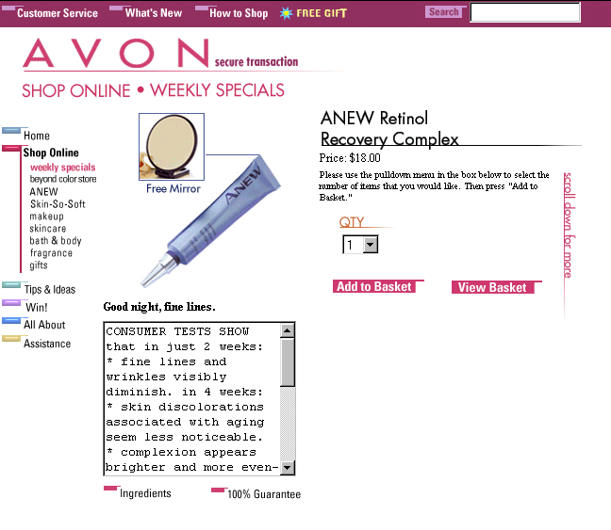
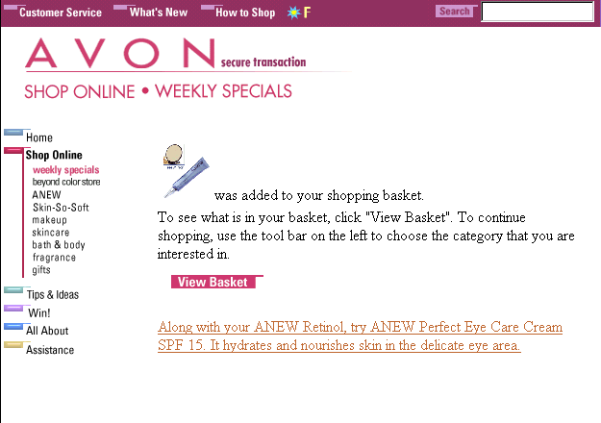
E-Biz Opportunity:Enhancing Shopping Experience;Enhanced Merchandising Techniques example: www.avon.com
URL: http://shop.avon.com/avonshop/
Avon suggests a related product for the consumer to purchase.

Slide 6
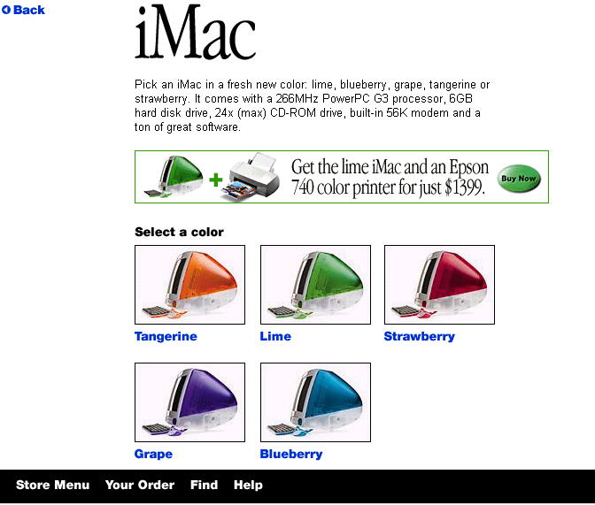
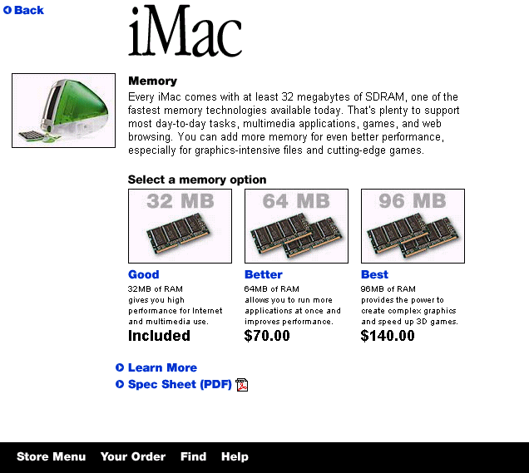
E-Biz Opportunity: Enhancing Shopping Experience;Enhanced Merchandising Techniques
Website example: www.apple.com
URL: http://store2.apple.com/1-800-795-1000/WebObjects/AppleStore.woa/4096851651988599489045886183201397/AppleStore.wo/51973501020397/0/2/order3.apple.com
During the purchase process, Apple offers the customer the opportunity to upgrade certain components of the computer. It clearly tells you
that although the included memory option is good, the customer can upgrade by selecting a better option.

Slide 7
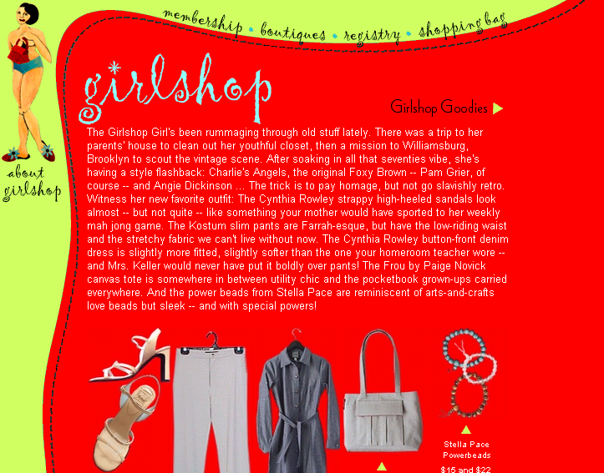
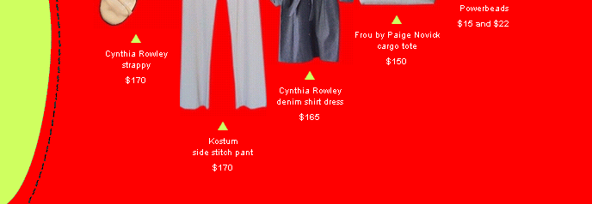
E-Biz Opportunity: Enhancing Shopping Experience;Enhanced Merchandising Techniques
Website example: www.girlshop.com
URL: http://www.girlshop.com
Girshop offers product suggestions to achieve the latest look.

Slide 8
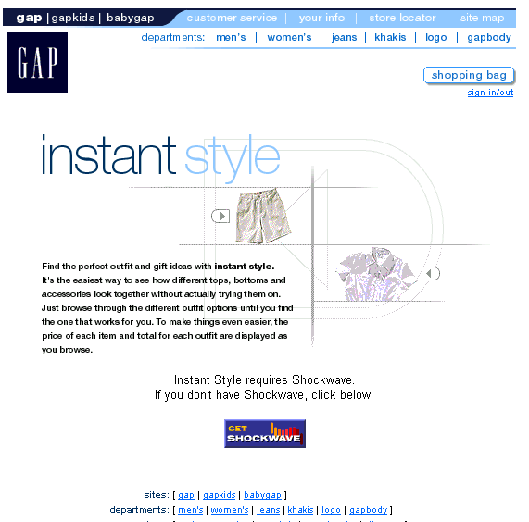
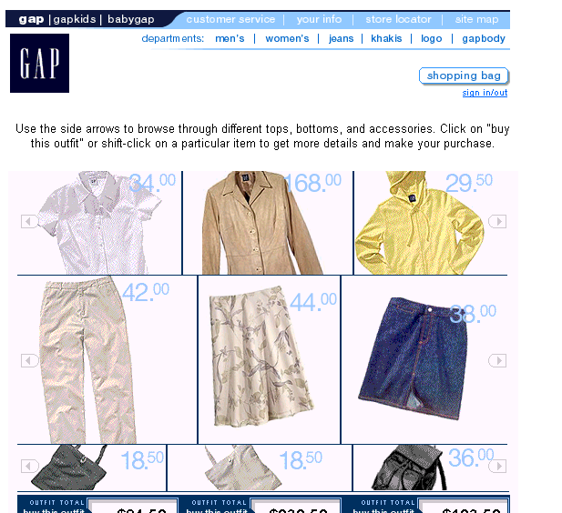
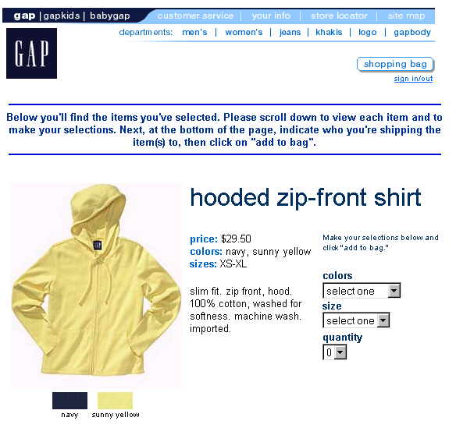
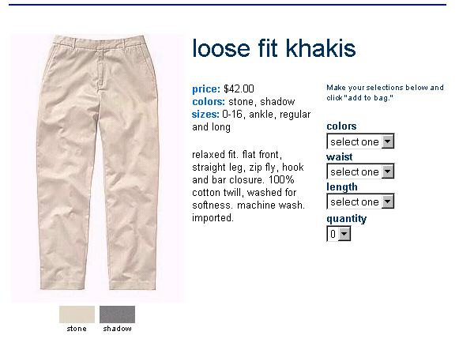
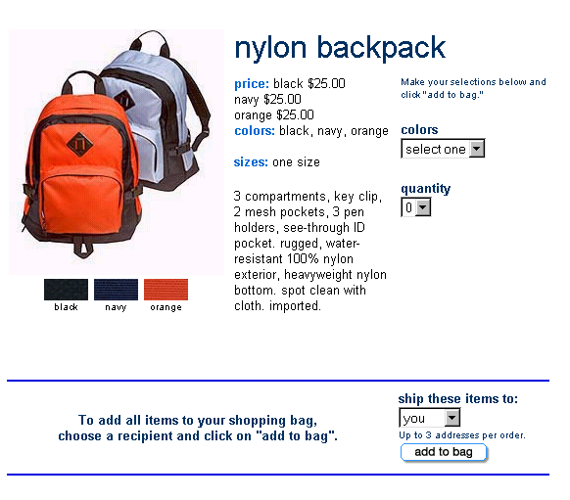
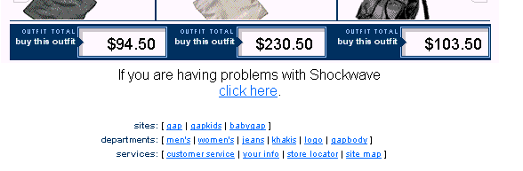
E-Biz Opportunity: Enhancing Shopping Experience;Enhanced Merchandising Techniques
Website example: www.gap.com
URL: http://www.gap.com
After the consumer
selects the outfit, s/he still has the option to buy all, part or none of the outfit.
Using Gap’s Instant Style, consumers can mix and match tops, bottoms with accessories from Gap.
Buy the outfit option
Gives the consumer the total price of the outfit s/he has selected.

Slide 9
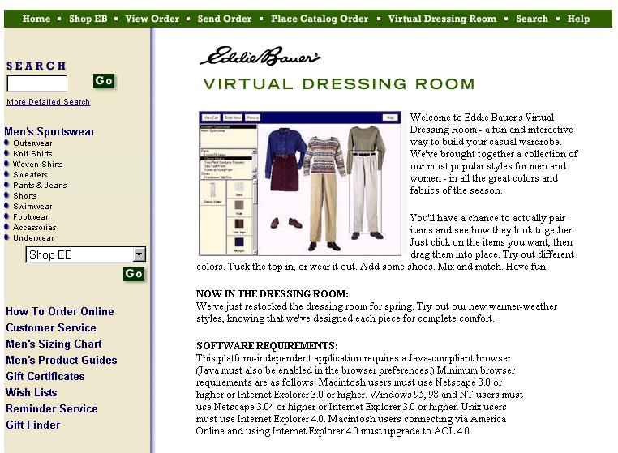
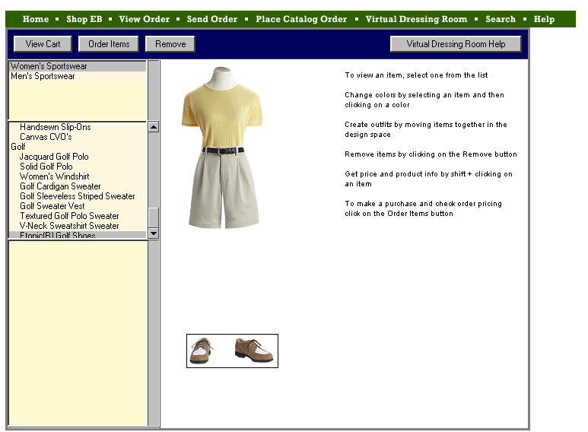
E-Biz Opportunity: Enhancing Shopping Experience;Enhanced Merchandising Techniques
Website example: www.eddiebauer.com
URL: http://www.eddiebauer.com/v_dressingroom/vdr/frame_vdr.asp
Can select from women’s or men’s sportswear
Consumers can use this option to remove items.
Help
With Eddie Bauer’s Virtual Dressing Room, the consumer can select tops, bottoms and accessories to see if they match.

Slide 10
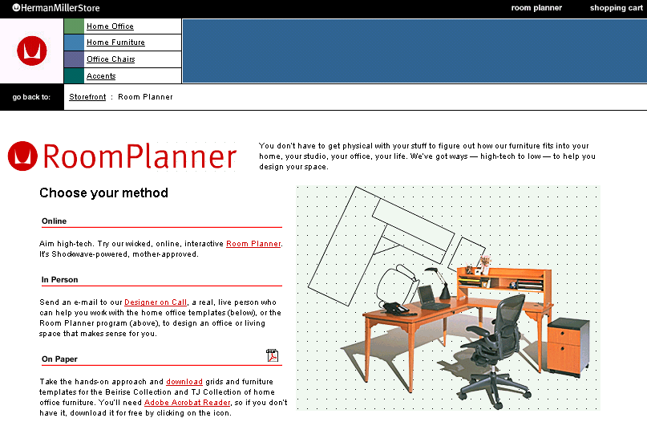
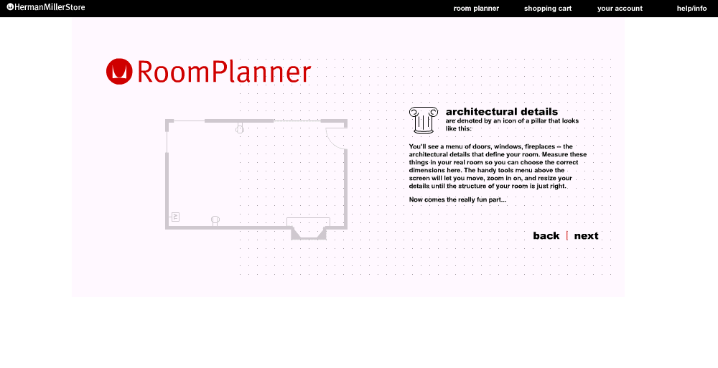
E-Biz Opportunity:Enhancing Shopping Experience;Enhanced Merchandising Techniques
Website example: www.hmstore.com
URL: http://www.hmstore.com
Simple instructions/steps
Different options to use the program

Slide 11
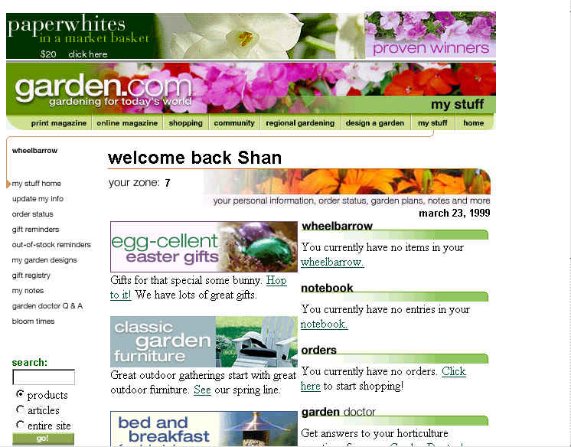
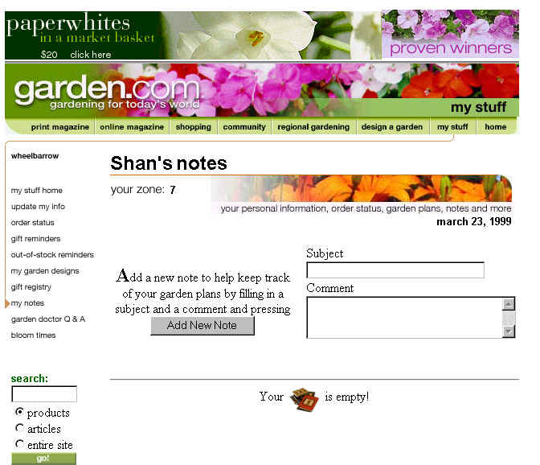
E-Biz Opportunity:Enhancing Shopping Experience;Personalization
Website example: www.garden.com
URL: http://www2.garden.com/cgi-bin/v2/gemag/PID=68009222219025442222164,24108&s=1238
My Stuff page
Shows the customer’s name
A notebook page where the customer can add new comments

Slide 12
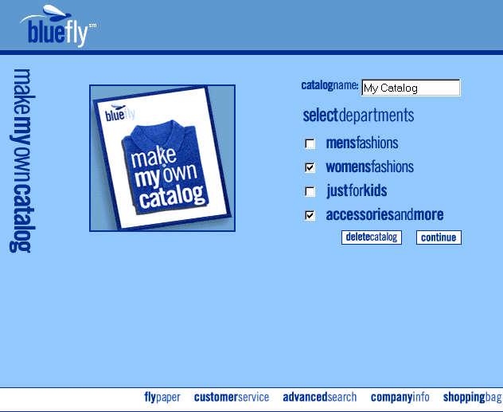
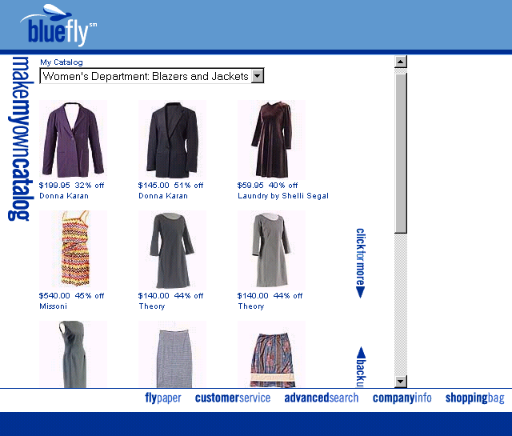
E-Biz Opportunity: Enhancing Shopping Experience;Personalization
Website example: www.bluefly.com
URL: http://www.bluefly.com/frameset.asp?zone=mycatalog&sid=2HQBE5H6SPSH2LTC001PQWUGDE902D21
The customer can give a title to his/her catalog.
Make my own catalog option
Customer can choose to include some or all of these categories in his/her catalog.
Items displayed based on the customer’s profile.

Slide 13
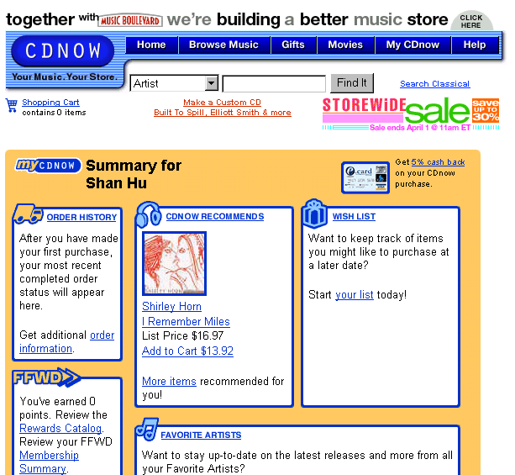
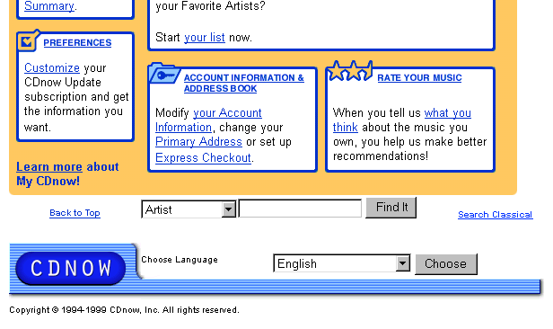
E-Biz Opportunity: Enhancing Shopping Experience;Personalization
Website example: www.cdnow.com
URL: http://www.cdnow.com
My CDNow on navigation bar.
Summary page for the consumer with his/her name on it.
Customer order information
A wishlist modified by the customer.
Rewards program based on past purchases
Favorite artists
Preferences
Customers can rank their purchases.

Slide 14
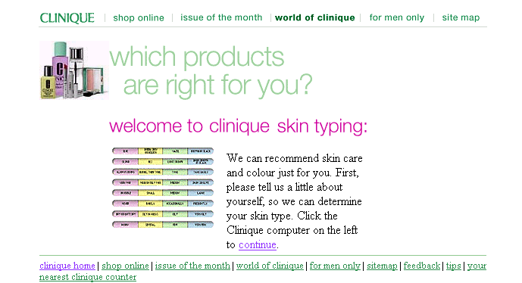
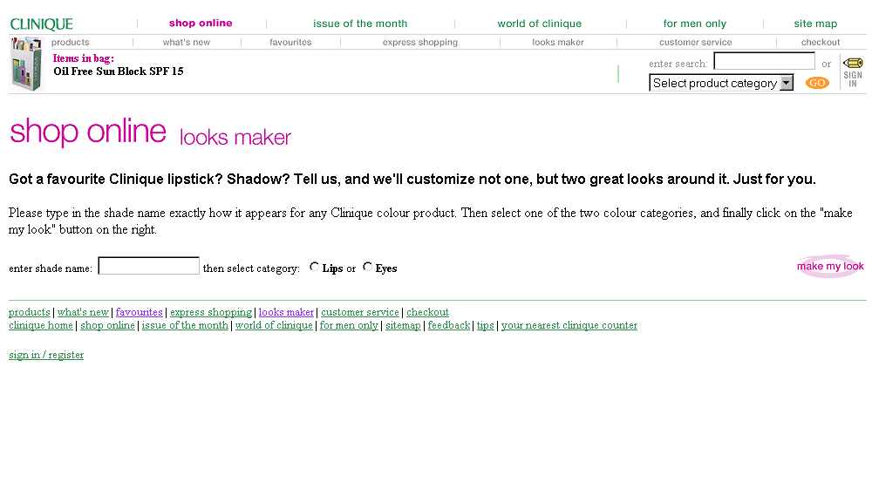
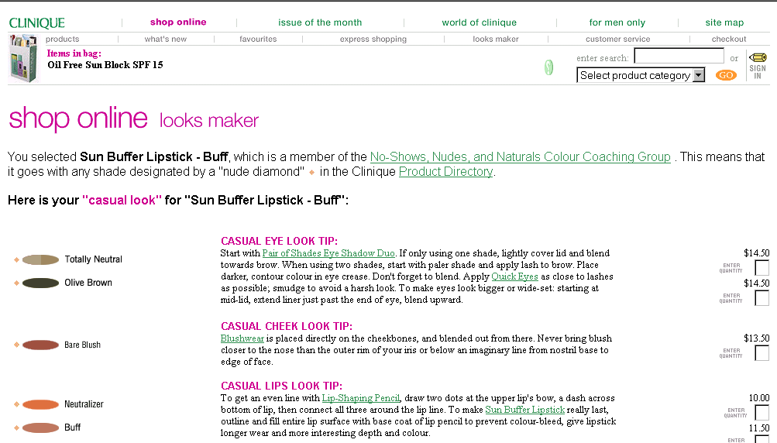
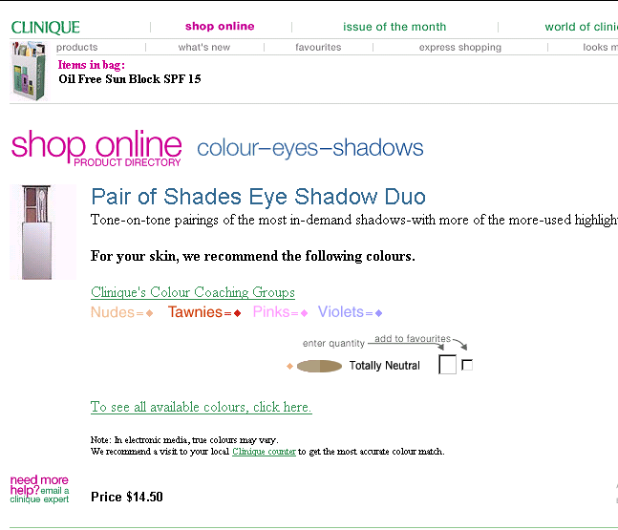
E-Biz Opportunity: Enhancing Shopping Experience;Product Recommendation
Website example: www.clinique.com
URL: http://www.clinique.com
Clinique’s Look Maker
Clinique’s Skin Typing
Enter favorite color lipstick
Clinique Looks Maker than makes recommendations based on the lipstick color.
Clinique provides a recommendation based on the consumer’s answers during the Skin Typing process.

Slide 15
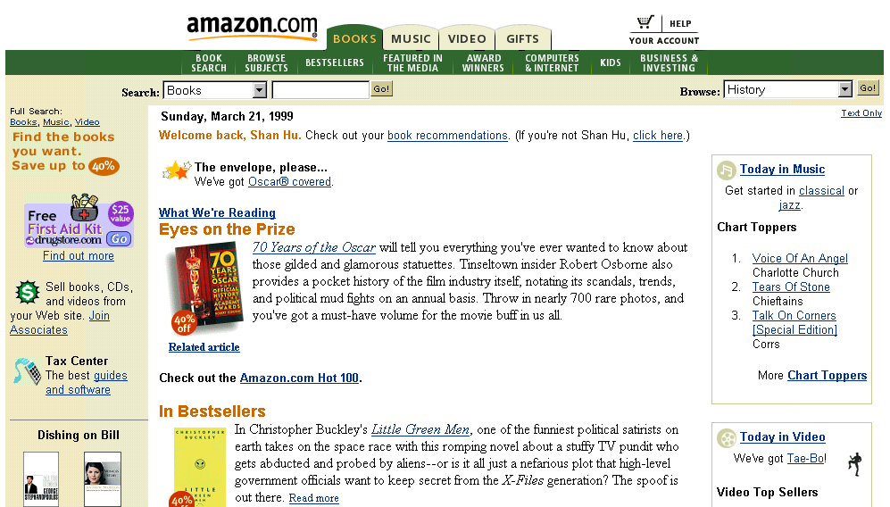
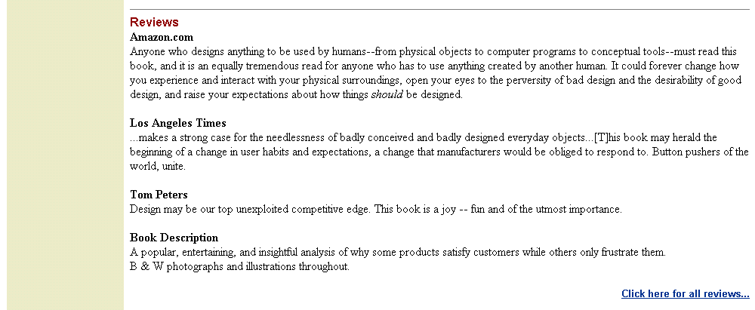
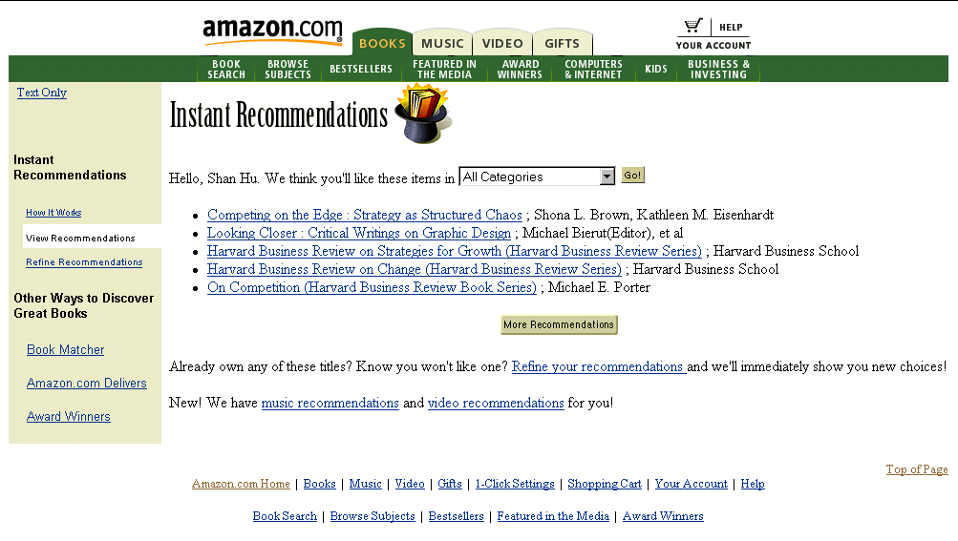
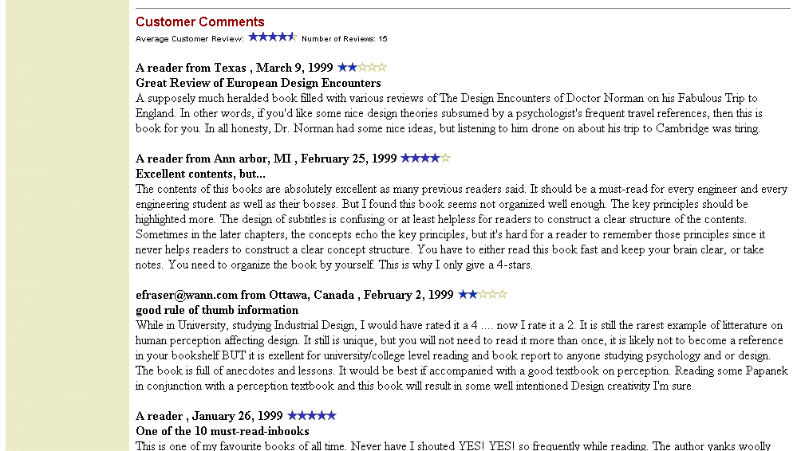
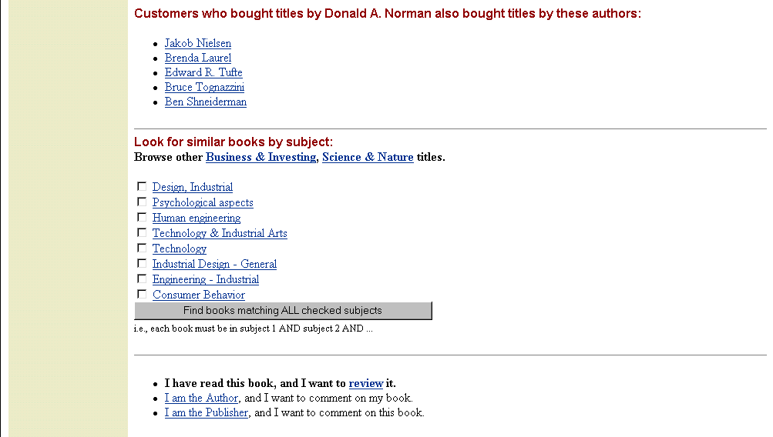
E-Biz Opportunity: Enhancing Shopping Experience;Product Recommendation
Website example: www.amazon.com
URL:http://www.amazon.com
Book Recommendations link
Reviews from Amazon
Reviews from the LA Times
Instant recommendations based on the consumer’s past purchases.
Comments from other
customers who read the
book.
Music recommendations link
Other author recommendations based on other customers purchasing behavior.
Video recommendations link
Customers have the opportunity to review any of the books s/he has read.

Slide 16
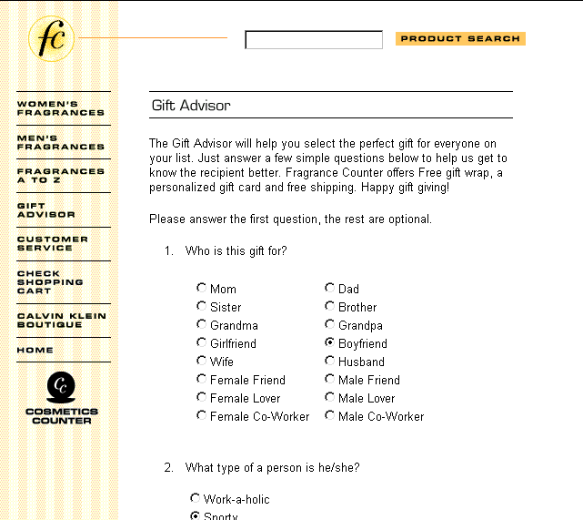
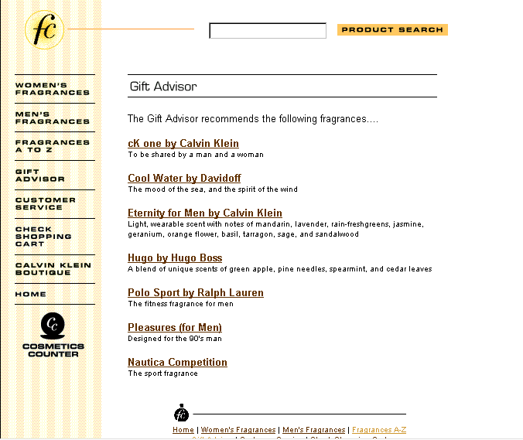
E-Biz Opportunity: Enhancing Shopping Experience;Product Recommendation
Website example: fragrancecounter.com
URL: www.fragrancecounter.com
Fragrance Counter’s Gift Advisor
Recommendations based on the
answers from the list of questions.
List of questions

Slide 17
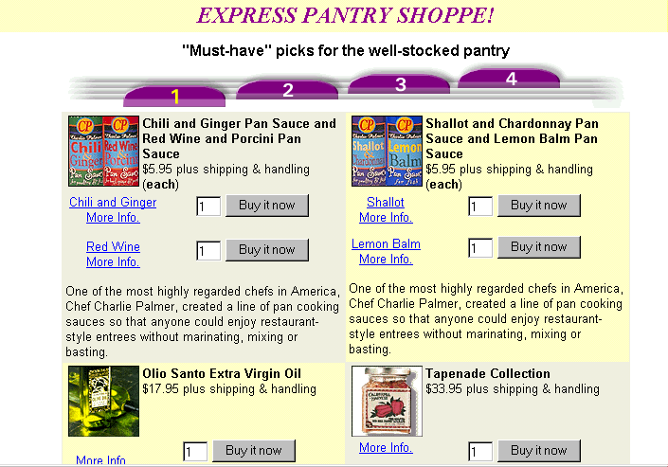
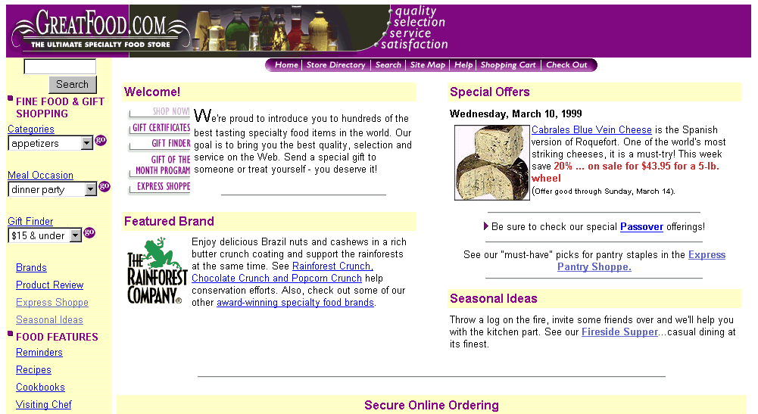
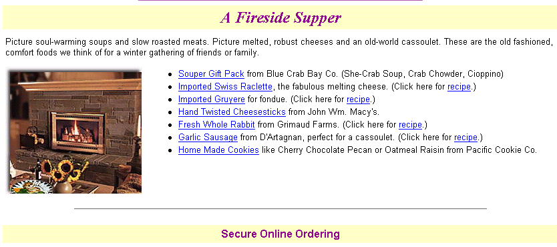
E-Biz Opportunity: Enhancing Shopping Experience;Product Recommendation
Website example: www.greatfood.com
URL: http://www.greatfood.com/products/grtfood/html/gfshop.htm
Recommendations for pantry must haves.
Recommendation of products for a fireside supper.

Slide 18
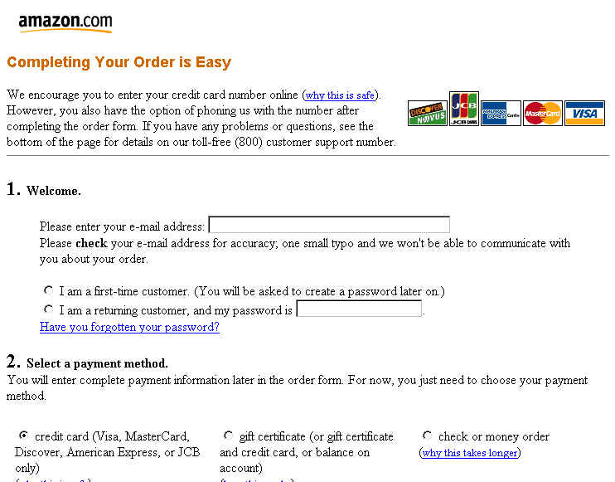
E-Biz Opportunity: Enhancing Shopping Experience; Convenience/Efficiency
Website example: www.amazon.com
URL:http://www.amazon.com/exec/obidos/ASIN/0814403271/ref=recs_books/002-8071480-5328425
Customer information is saved for convenience.

